Slide 1
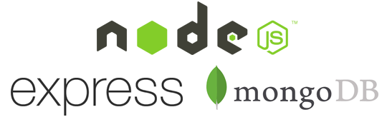
COM3123 - Lecture 5
Express & MongoDb

Slide 2
Topics
Javascript Refresher
Promises
Express
REST Api
Middleware
MongoDb
Relational vs NoSQL

Slide 3
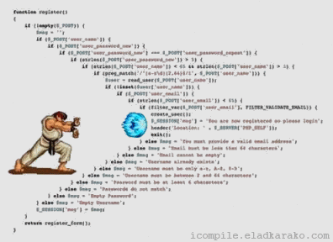
Callback revisited
Callbacks are one of the most confusing concepts.
One of the biggest problems of callbacks is the chaining of different asynchronous activities.
You end up calling anonymous function after function to pass around values.
The result is an unmaintainable “callback hell” or pyramid of doom.

Slide 4
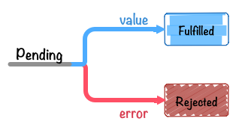
Promises
Promises attempt to solve the callback hell problem with asynchronous operations
A Promise represents a value which may be available now, or in the future, or never.
A Promise is a special storage state object, at first it has a pending, after it is either ‘fulfilled (resolved)’ or ‘reject’

Slide 5
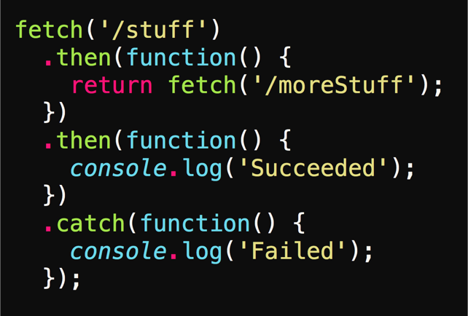
Promise Chaining
The then() method returns a Promise which allow for chaining.
The callback function in then can return a resolve or reject.

Slide 6
Express & Middleware

Slide 7
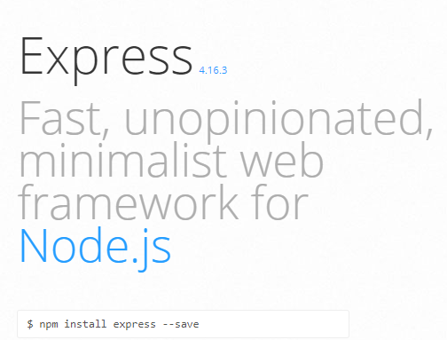
Express for Node.js
web application framework, designed for building single-page, multi-page and hybrid web applications
minimalist, yet full featured
Built-in support for routing & varous HTTP handlers, configuration, session management and middleware
amazing community
http://expressjs.com/

Slide 8
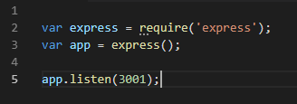
Installing & Setup Express
Install Express on command line (development or global dependencies)
Create a new instance of the express object, set the port and it will begin listening

Slide 9
HTTP Method
Specifies the type of action the request wishes to make
GET, POST, DELETE etc. These are called verbs.
Server responds to the verbs and takes action
GET - Fetches data
POST - Adds new data
PUT - Updates data
DELETE - Delete data

Slide 10
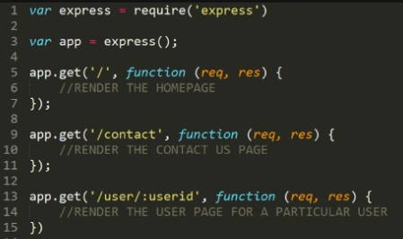
Defining Routes
Express apps can respond to various HTTP verbs as API methods
Route can have the same name, as long as verb is different, it will be handled separately

Slide 11
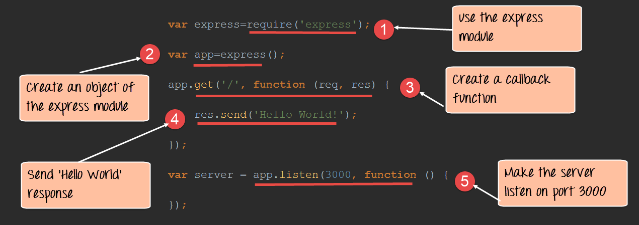
Using the Express module

Slide 12
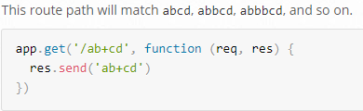
Routing Matching
Express will respond to HTTP verbs and routing, but will also provide routing matching
Route Matching is utilities for pattern matches on the route path
http://expressjs.com/en/guide/routing.html

Slide 13
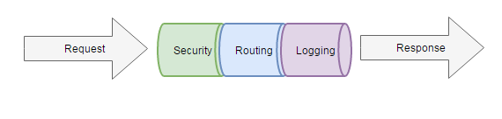
Middleware
Code that sits between two layers of software
With Express, the middleware is sitting between the request and response

Slide 14
Middleware
Middleware is a pipeline of code that gets called before your request handler
Express applications are basically a bunch of middleware calls
Middleware can:
Execute any code
Make changes to the request and the response objects
End the request-response cycle
Call the next middleware in the stack

Slide 15
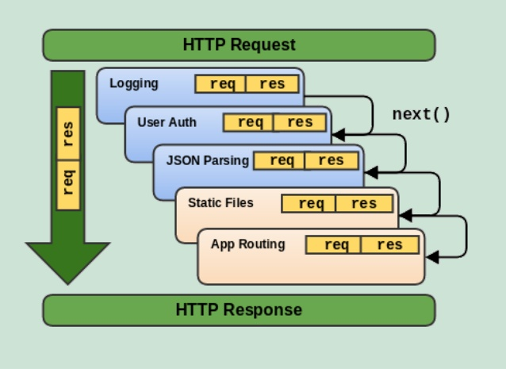
Express Middleware
Middleware is a function with access to the request object (req)
and the response object (res)
Also, has access to the next middleware object (next) in line in request-response cycle of Express application

Slide 16
Express Middleware modules
Some useful Express maintained middleware and 3rd party middleware can be found here:
https://expressjs.com/en/resources/middleware.html
Some popular middleware include:
CookieParser - parse cookie header
BodyParser - parse the HTTP request body
Passport - simple, unobtrusive authentication for Node.js

Slide 17
Serving Static Files with Express
To serve static files such as images, CSS files and JavaScript files use the express.static built-in middleware function in Express
The function signature is express.static(root, [options]) where root is the root directory from which the serve the static assets.
For example, to serve images, CSS files and JavaScript from the public directory use.

Slide 18
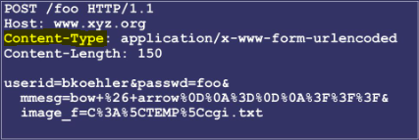
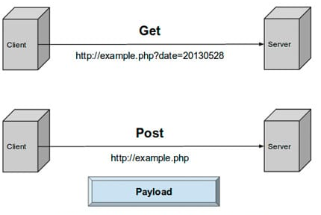
POST vs GET HTTP Requests
GET is a method that sends information by appending to page request
POST is a method that transfers information via HTTP header
* Payload = QueryString is actually moved to the body of the message.

Slide 19
REST
REST is an architectural style for building APIs
Representational State Transfer
The HTTP verbs and URLs have meaning.
We organize and build our APIs to use HTTP verbs and URLs to match HTTP Requests in a meaningful way.

Slide 20
NOSQL and MongoDB

Slide 21
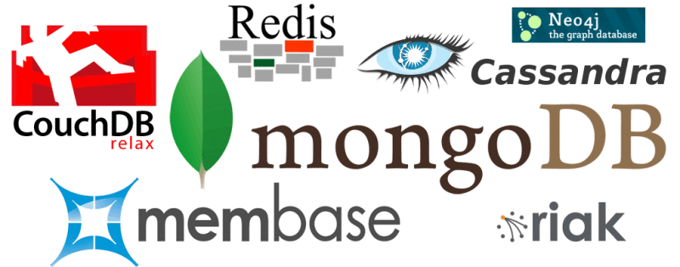
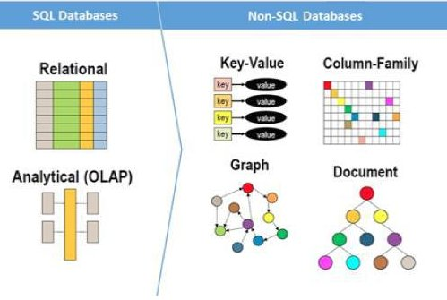
NOSQL
Non-relational database
Does not require a schema
Cheap and easy to implement (open source)
Massive write performance
Fast-key value access

Slide 22
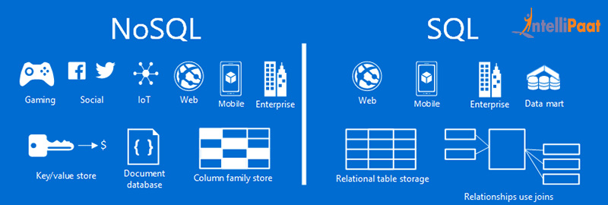
SQL vs NOSQL
Schema free
Scalable
Flexible
Limited queries
Emerging
Relational Schema
Consistent
Rigid
Mature
Stable

Slide 23
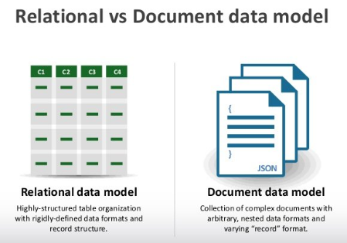
Relational vs Non-Relational Databases
A non-relationship database does not incorporate the table model. Instead, data can be stored in a single document file.
A relational database table organizes structured data fields into defined columns.

Slide 24

MongoDB
Document-oriented NoSQL database
JSON-like documents with dynamic schema
Highly performant when indexing support is used
A natural fit for Node and Express applications
Use JSON for queries
** NO Table JOINS!
https://www.mongodb.com/

Slide 25
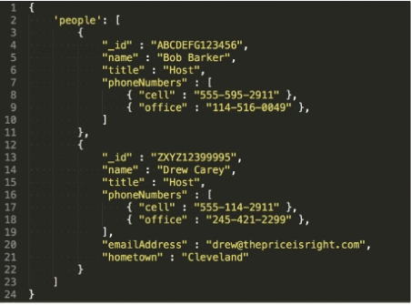
MongoDB Document based
A document in MongoDB, notice the JSON schema

Slide 26
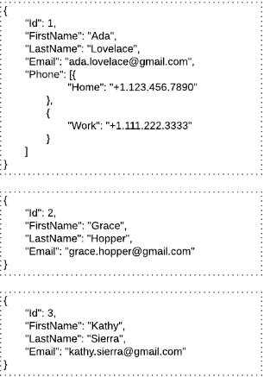
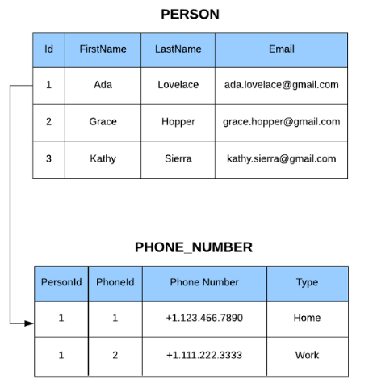
MongoDB Document vs SQL Table

Slide 27
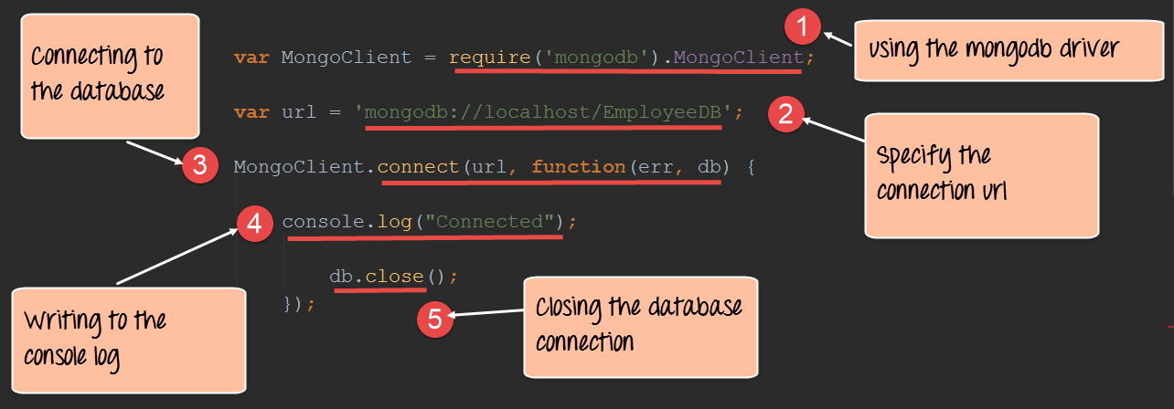
Using the Mongo Client driver

Slide 28
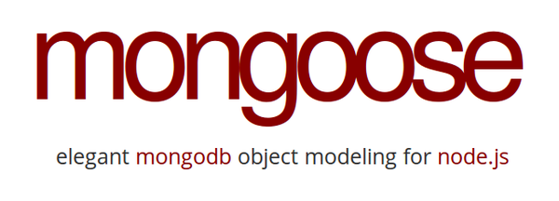

Mongoose
Alternative middleware to MongoDB Drive
Mongoose is an object modeling package for Node that essentially works like an ORM
Mongoose allows us to have access to the MongoDB commands for CRUD simply and easily.
https://mongoosejs.com/

Slide 29


Using Mongoose
Install it via npm
Require the package in our project
Connect to the MongoDB

Slide 30
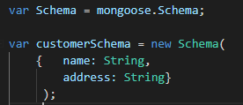
Defining Mongoose Schemas & Models
Everything in Mongoose starts with a Schema. Each schema maps to a MongoDB collection and defines the shape of the documents within that collection.
Creating a model from our schema definition

Slide 31
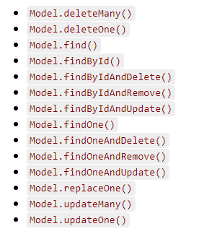
Mongoose Queries
Mongoose models provide several static helper functions for CRUD operations. Each of these functions returns a mongoose Query object.
* Remember CRUD stands for Create, Update, Delete.

